Slide 1


Slide 2
DATA SCIENCE Definition
Data Science is the process of using data to find solutions/ to predict outcomes for a problem statement.
Data science is an interdisciplinary field that uses scientific methods, processes, algorithms, and systems to extract knowledge and insights from structured and unstructured data. In simpler terms, data science is about obtaining, processing, and analyzing data to gain insights for many purposes.

Slide 3
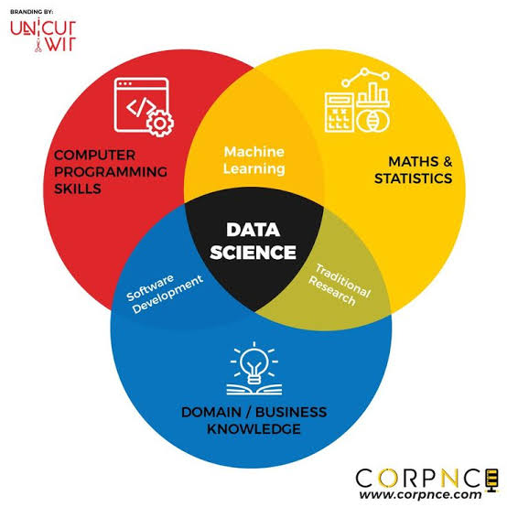
Data science is the study of data to extract meaningful insights for business. It is a multidisciplinary approach that combines principles and practices from the fields of mathematics, statistics, artificial intelligence, and computer engineering to analyze large amounts of data.

Slide 4
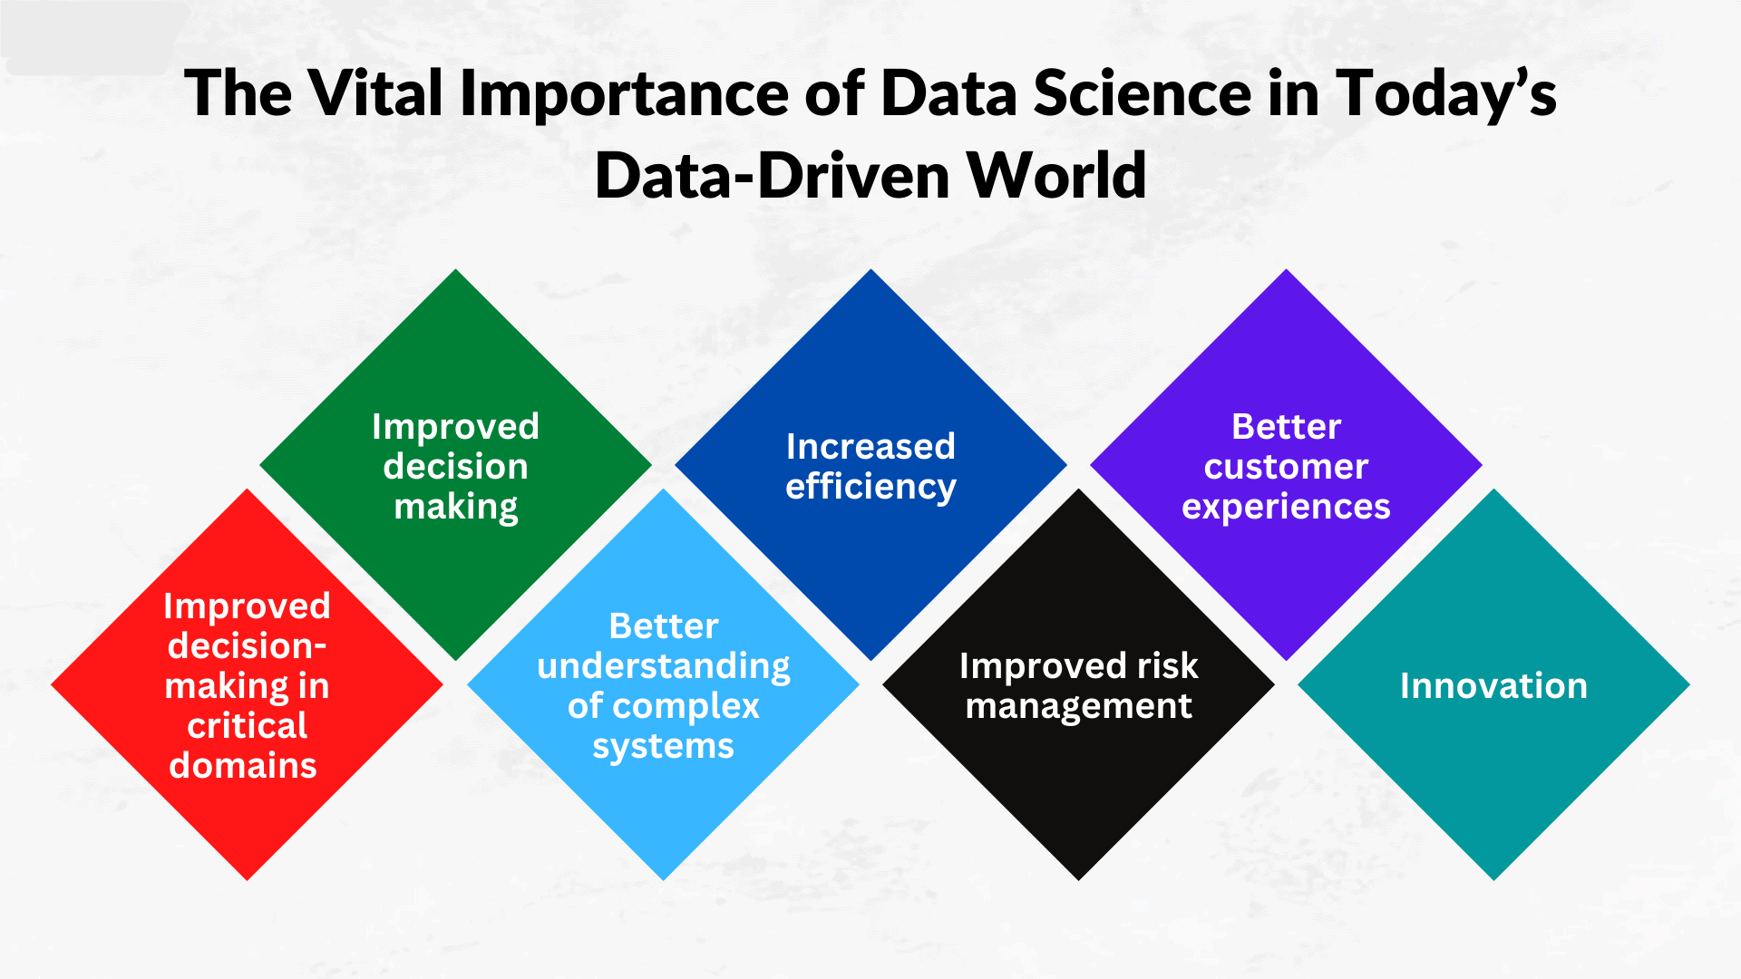

Slide 5
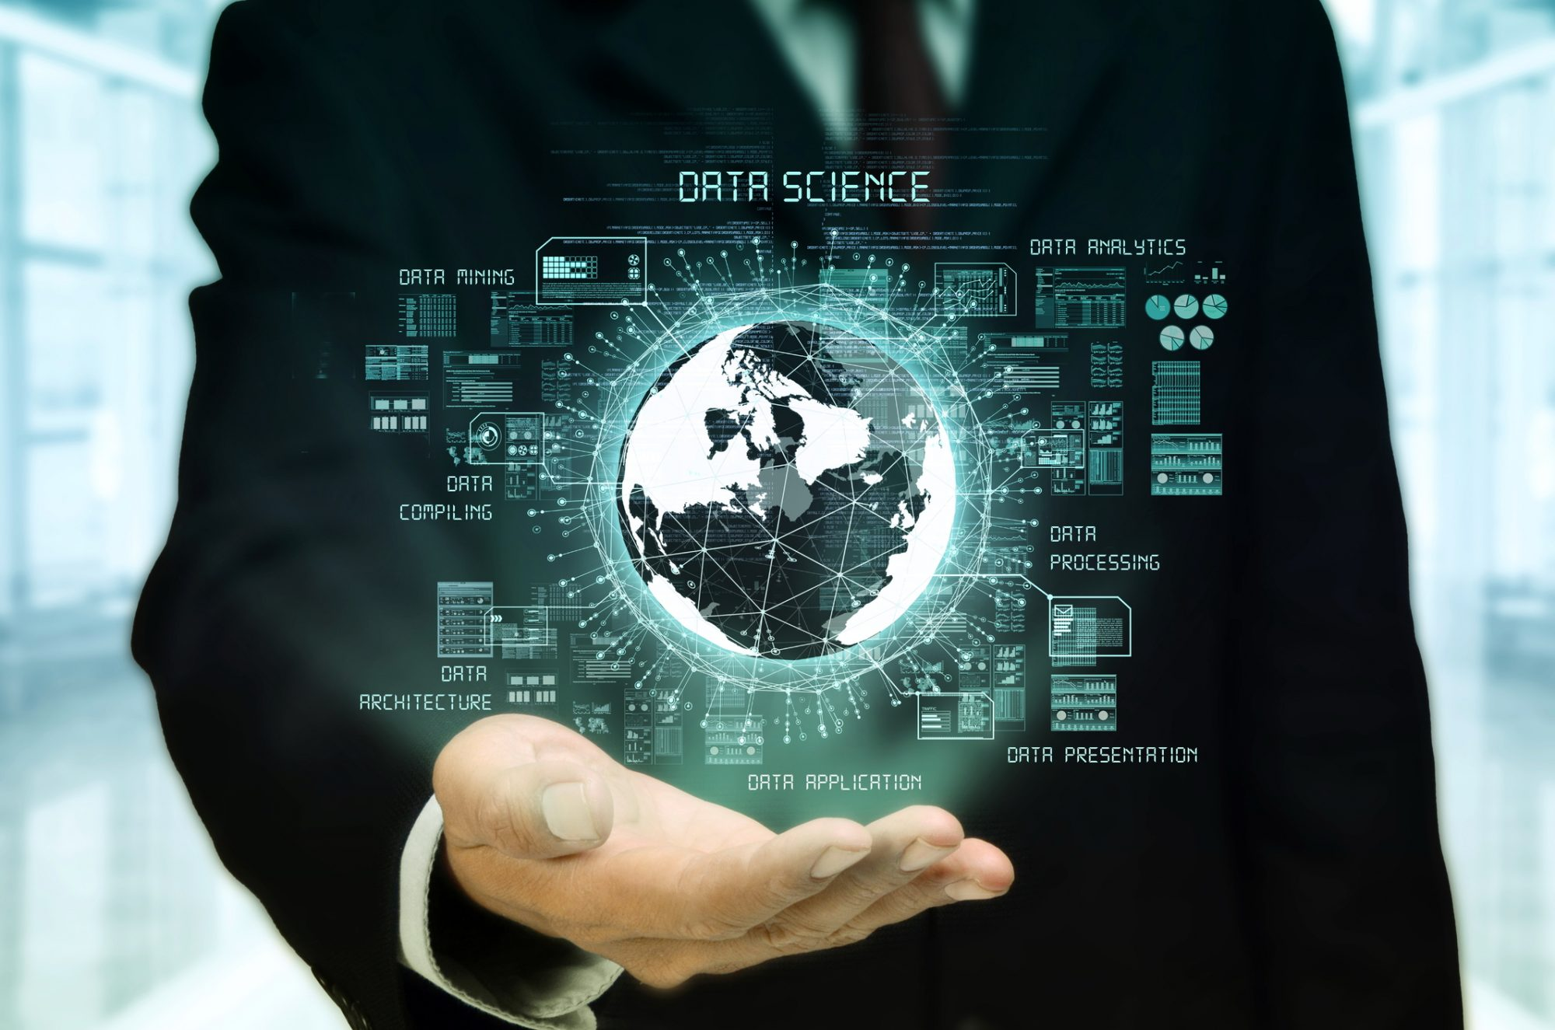
Applications of data science
It is used in many industries these days ,ranging from entertainment to education .
Data science is quickly becoming one of the most in-demand disciplines, with applications in a wide range of sectors. We know it has been revolutionizing the way we perceive data.

Slide 6
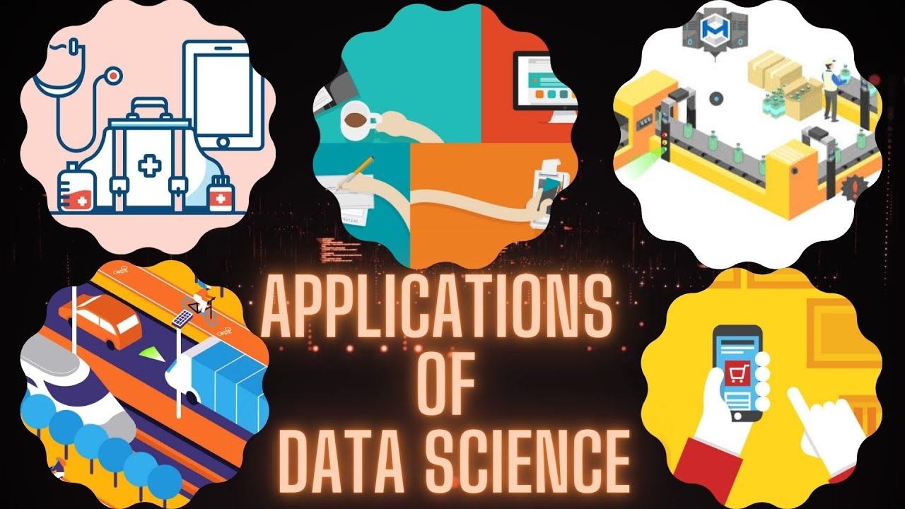
Applications of Data Science in different sectors :
MANUFACTURING
Predicting potential problems.
Automatic manufacturing units.
E-COMMERCE
Identifying consumers.
Recommending products.
BANKING
Fraud detection.
Credit risk modelling.
TRANSPORT
Enhancing safety of passengers.
Car monitoring systems.

Slide 7
HEALTHCARE
Image Analysis in Medicine
Genetics and Genomics
Drug Development
Virtual Assistants and Health bots
TEXT and ADVANCED IMAGE RECOGNISATION
When we upload our image with our friend on Facebook, Facebook gives suggestions Tagging who is in the picture. This is done with the help of machine learning and Data Science.
GAMING
EA Sports, Zynga, Sony, Nintendo, and Activision-Blizzard have all used data science to take gaming to the next level.
SECURITY
Data science may be utilized to improve your company's security and secure critical data. Banks, for example, utilize sophisticated machine-learning algorithms to detect fraud based on a user's usual financial activity.

Slide 8



Brands using data Science Applications in real life
Entertainment
E-Commerce
Automobile

Slide 9
THANK YOU
By T Eswarreddy

